Slide 1
Evolution of Natural Language Processing: A Comprehensive Analysis in Sentiment Classification from Naive to Pre-trained LLMs (BERT & GPT)
S Lakshmi Devi

Slide 2

Problem Statement
Evolution of NLP in Sentiment Analysis:
Analyze the progression from traditional models like Naive Bayes to advanced transfer learning models in sentiment analysis.
Comparative Architecture Analysis:
Compare the architectures of different ML,DL, transformer models, highlighting
their strengths and limitations.
Descriptive Vs Generative Models:
Evaluate BERT and GPT models for sentiment analysis on the IMDB dataset, focusing on time, resource usage, and contextual understanding.

Slide 3

Natural Language Processing
NLP is a branch of AI that focuses on enabling machines to understand, interpret, and generate human language.
Early (1950s-1990s): Early NLP methods used rule-based systems and statistical models for basic tasks
like word segmentation and machine translation, struggling with language complexities.
Statistical and ML(1990s-2000s): Machine learning models like Hidden Markov Models (HMMs)
and Support Vector Machines (SVMs) improved tasks such as named entity recognition
and sentiment analysis.
Deep Learning (2010s): Deep learning methods like RNNs and LSTMs, along with word embeddings like
Word2Vec, enhanced context handling and semantic understanding in NLP tasks.
Transfer Learning (2018-Present): Transformer architectures like BERT and GPT, using attention mechanisms and pre-
training, revolutionized NLP, setting new performance benchmarks across multiple
tasks.

Slide 4

Sentiment Classification
The process of using NLP and machine learning to identify and extract subjective information from text, categorizing sentiment as positive, negative, or neutral.
Social Media Monitoring: Gauging public sentiment on brands, products, or political events.
.
Market Sentiment Analysis: Predicting stock movements and consumer behavior by analyzing sentiment in news and social media.
Customer Feedback Analysis: Improving products and services based on customer sentiment.

Slide 5
Evolution of SA : Architectural Insights
Naive Bayes Relies on word frequency and assumes independence between words, providing a fast but
less accurate method for sentiment analysis.
Recurrent Neural Networks (RNN) Processes sequential data by maintaining memory of previous words, improving context capture,
but struggles with long-range dependencies.
Long Short-Term Memory (LSTM) Effectively manages long-term dependencies in text, making it more accurate
for sentiment analysis in longer or more complex sentences.
Transformer Models (BERT, GPT) Utilizes attention mechanisms for contextual understanding, offering state-of-the-art performance
by capturing nuanced sentiment and context efficiently.

Slide 6
Naïve Bayes
What is Naive Bayes?
Naive Bayes is a probabilistic machine learning algorithm based on Bayes' Theorem, which predicts the probability of a class given input features. It assumes that features (e.g., words in text) are independent of each other—a "naive" assumption that simplifies computations.
How It Is Used in Sentiment Analysis
Text Representation: Converts text into a bag-of-words or term frequency representation.
Probability Calculation: Calculates the probability of a sentiment class (e.g., positive or negative) by analyzing the likelihood of words occurring in that class.
Classification: Assigns the sentiment label with the highest probability.

Slide 7
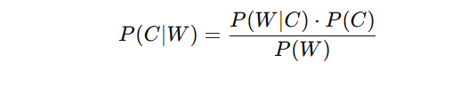
Naïve Bayes
Naive Bayes uses Bayes' Theorem to calculate the probability of a class (e.g., positive or negative sentiment)
given the features
P(C∣W) : Probability of class C (e.g., positive/negative) given the words
P(W∣C) : Probability of the words W appearing in class C.
P(C) : Prior probability of class C (e.g., the proportion of positive/negative reviews).
P(W) : Probability of the words W in the entire dataset (normalization factor, often
ignored during classification).

Slide 8
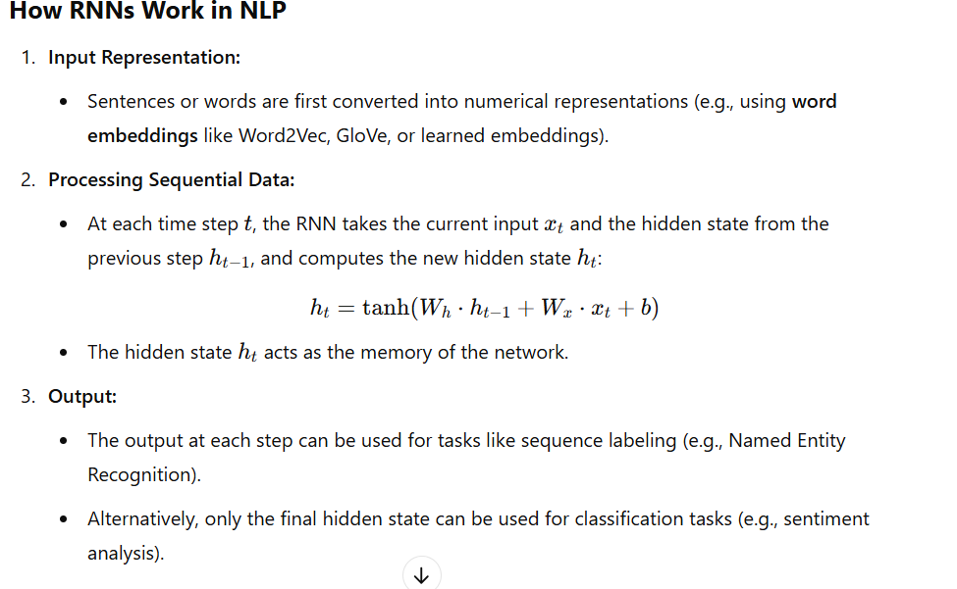
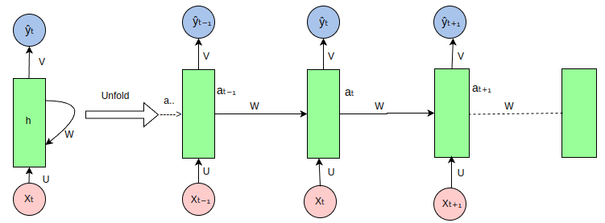
Recurrent Neural Network(RNN)

Slide 9
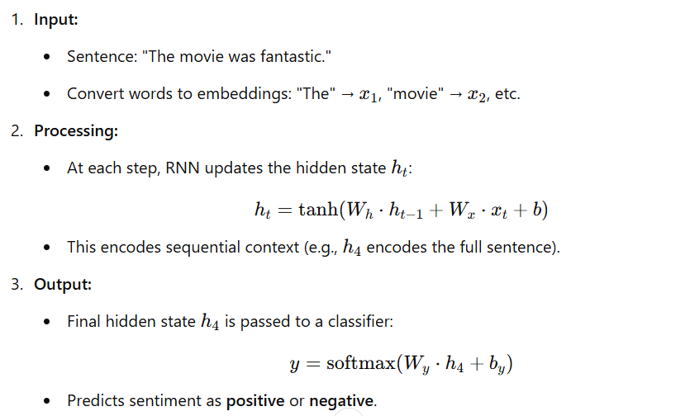
Recurrent Neural Network (RNN)

Slide 10
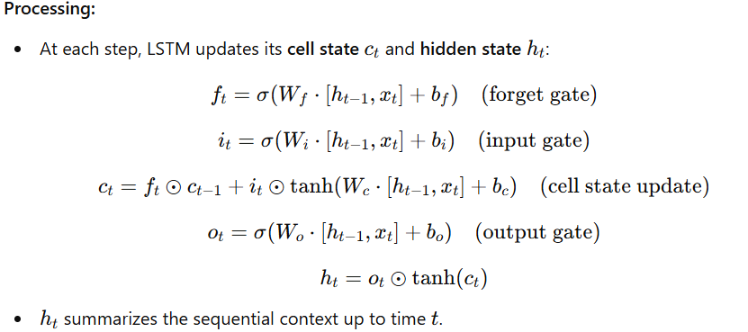
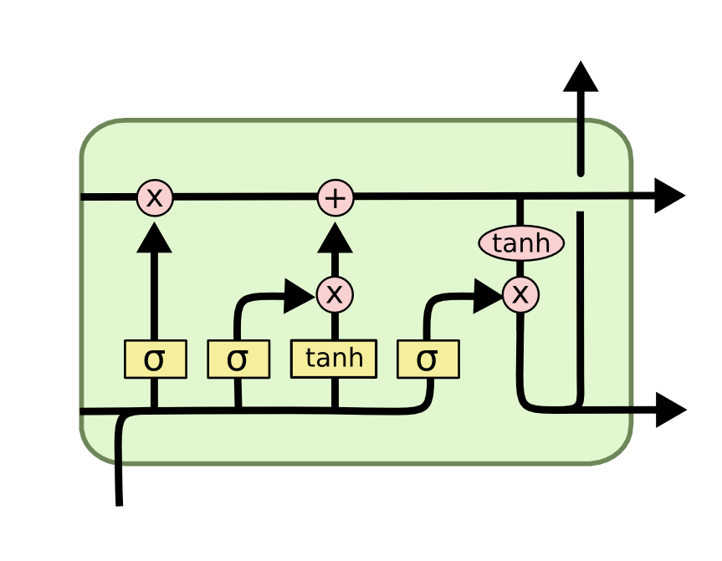
Long short term memory (LSTM)

Slide 11
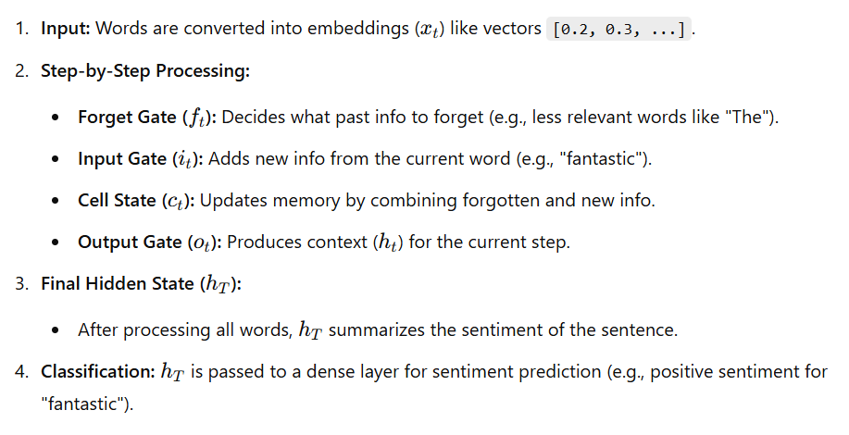
Long short term memory (LSTM)

Slide 12
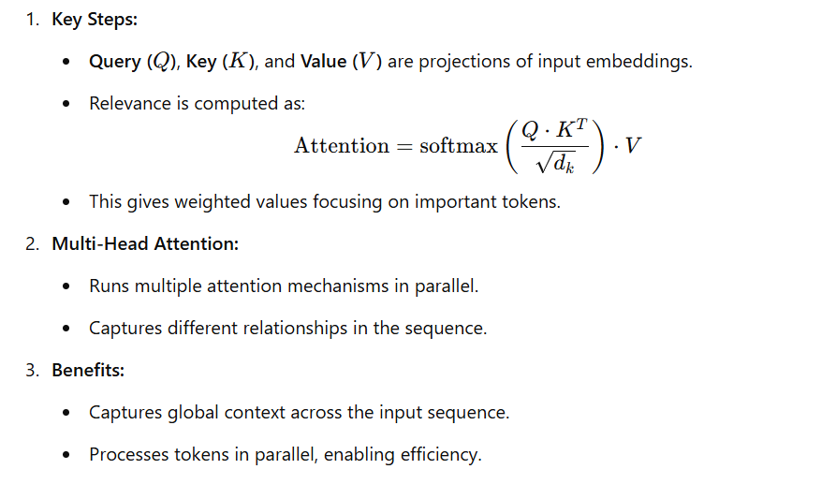
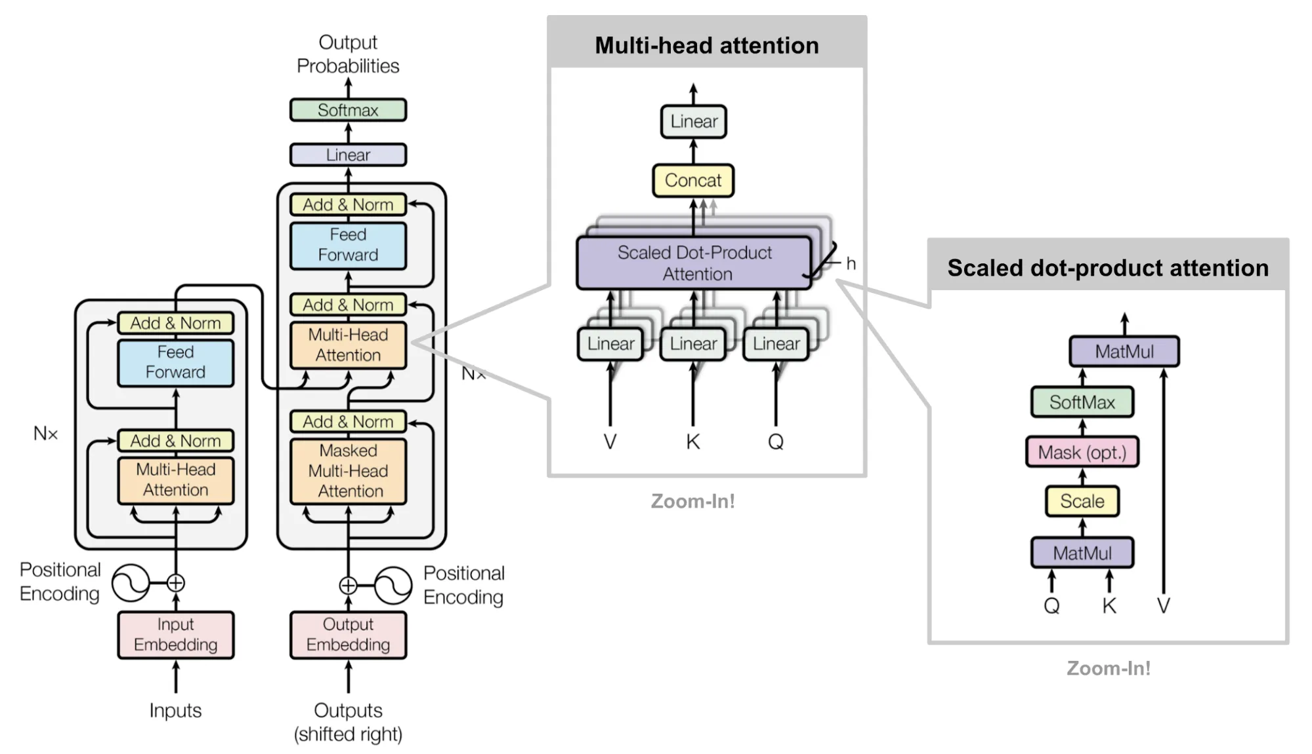
Transformers – Attention

Slide 13
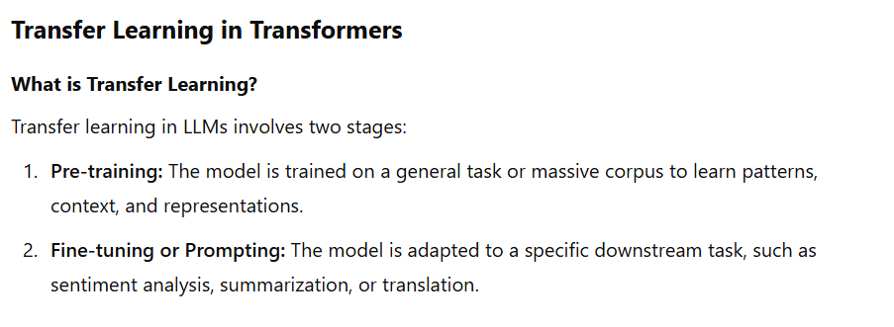
Large Language Models
LLMs are massive transformer-based models pre-trained on vast amounts of text data to perform a wide range of NLP tasks. They leverage transformer architecture and transfer learning to generalize across tasks with minimal or no task-specific training.

Slide 14
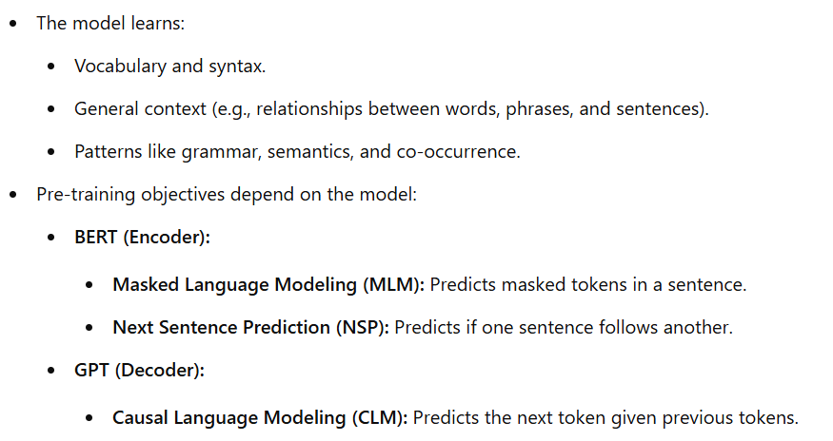
Pre Training in LLMs

Slide 15
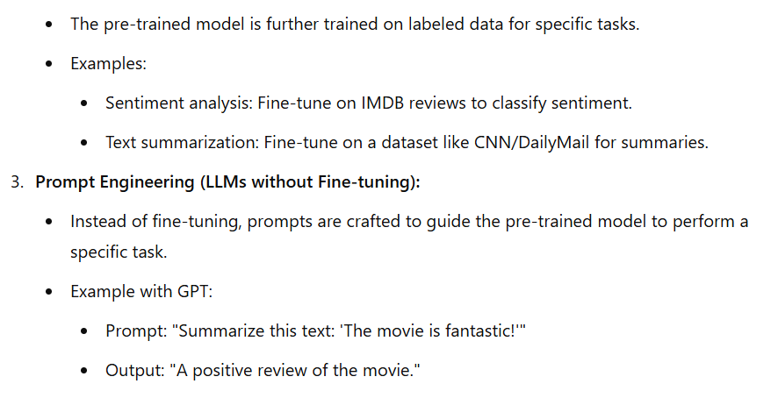
Fine Tuning in LLMs

Slide 16
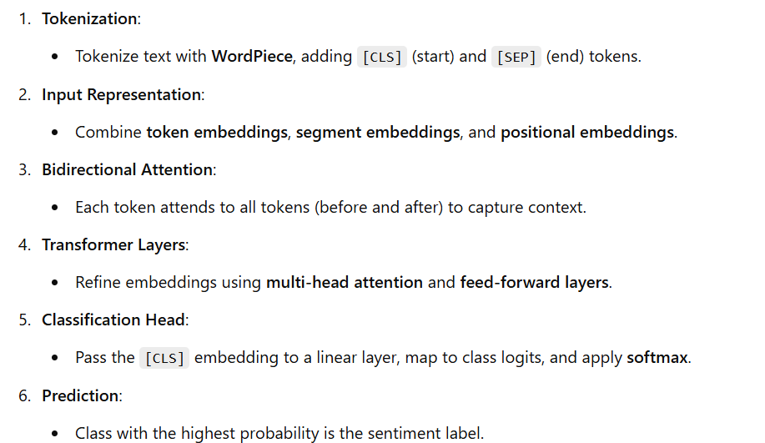
BERT (Bidirectional Encoder Representations from Transformers)

Slide 17
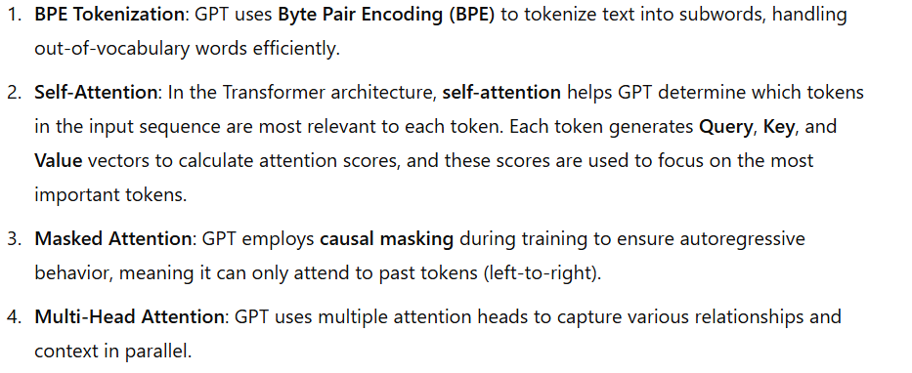
GPT (Generative Pre-trained Transformer)
5. Classification Head (For Sentiment Analysis): After the model processes the input using the above mechanisms, the output is passed through a classification head, which is a simple linear layer used to map the model's final hidden states (representing the input text) to a class label (e.g., positive or negative sentiment).

Slide 18
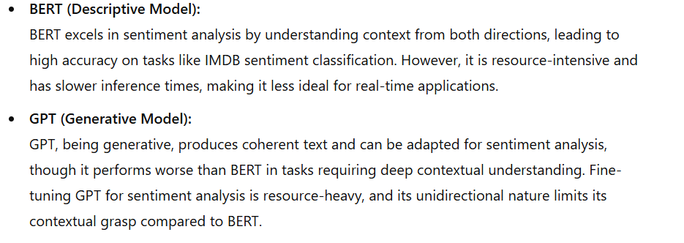
BERT & GPT in Sentiment Analysis

Slide 19
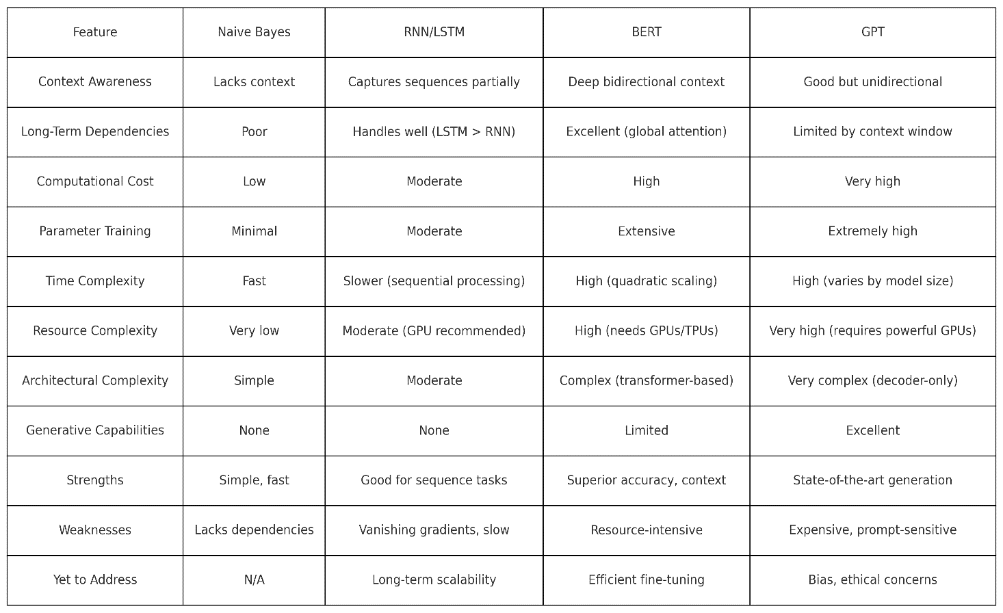
Comparative Study : Qualitative Analysis

Slide 20
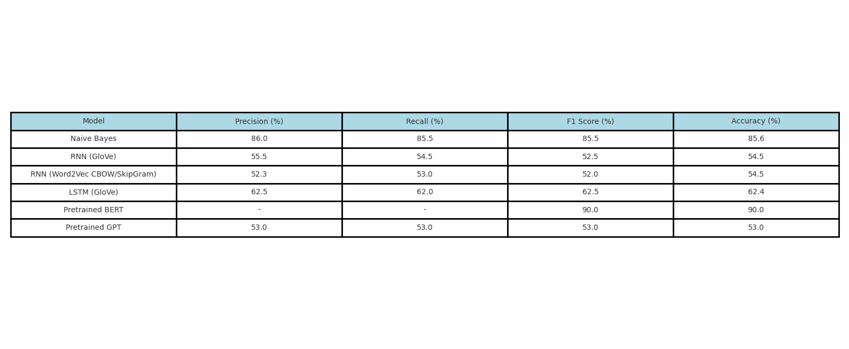
Comparative Study : Quantitative Analysis

Slide 21
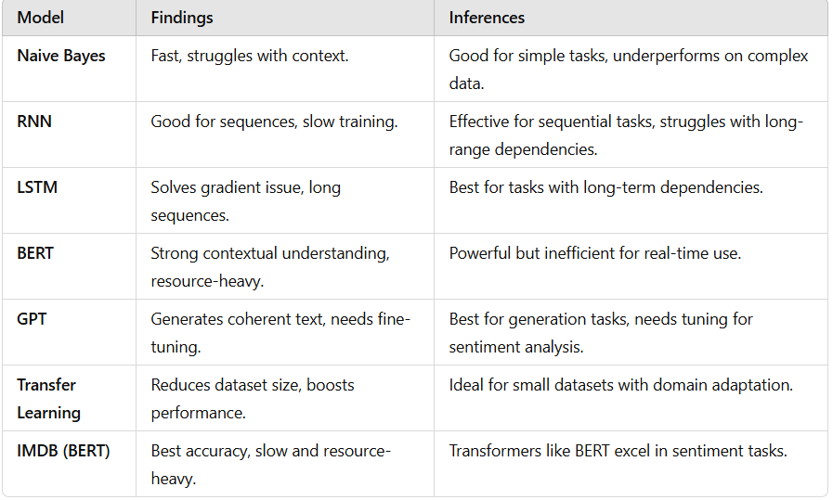
Findings and Inference

Slide 22
Findings and Inference
BERT outperforms GPT in sentiment analysis due to its bidirectional attention mechanism, which allows it to understand context from both directions, enhancing its ability to interpret sentiment. BERT is pre-trained for a wide range of tasks and can be fine-tuned effectively for sentiment analysis. In contrast, GPT, being unidirectional and primarily generative, requires more effort to adapt for sentiment tasks and struggles with contextual understanding.

Slide 23
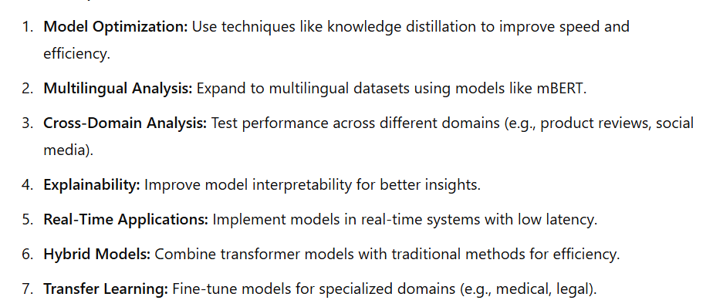
Future Scope

Slide 24
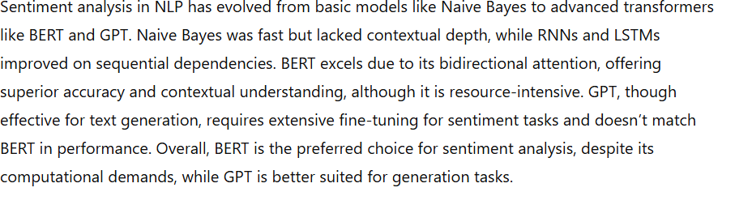
Conclusion

